Slide 1
Calibrating a macroprudential policy model for the Romanian economy
Phd Student: Aliman Mihai
Professor: prof. univ. dr. Necula Ciprian
FABBV Doctoral School Presentation, april 2023

Slide 2



European Authorities Approach
European authorities typically rely on DSGE models for calibrating and assessing their macroprudential policies, especially for ex ante analysis.
One of the first models adapted for macroprudential policy and still one of the most common used is Gerali et al. (2010).
European Central Bank Darracq Pariès, Jacquinot, Papadopoulou (2016)
Cozzi et al. (2021) Darracq Pariès, Kok Sørensen, Rodriguez-Palenzuela (2018)
Mendicino, Nikolov, Suarez, Supera (2018)
Coenen, Karadi, Schmidt, Warne (2018)
Banque de France Gerali, Neri, Sessa, Signoretti (2010)
Bennani et al. (2017) Mendicino, Nikolov, Suarez, Supera (2018)
Bundesbank Gerali, Neri, Sessa, Signoretti (2010)
Hristov și Hülsewig (2017)

Slide 3
Gerali et al. (2010) (1)
Pacient (higher discounting factors)
Households consume, work, accumulate housing
Impacient (lower discounting factors)
Entrepreneurs → produce homogenous intermediate goods using capital, bought from capital-good producers, and hired labor
Banks → offer saving contracts (deposits) and borrowing contracts (loans)
→ set interest rates so as to maximize profit (monopolistic behavior)
→ are subject to a capital requirement and it’s costly to hold more capital than the required level
→ the amount of loans issued can be financed through deposits and bank capital, which is accumulated out of profits.
Borrowing constraint → households can borrow against the value of their stock of housing, while entrepreneurs against physical capital
Patient households → purchase a positive amount of deposits and do not borrow, while impatient households and entrepreneurs borrow a positive amount of loans
Production side → workers supply their differentiated labor services through unions, which set wages to maximize members’ utility subject to adjustment costs.
→ in addition to entrepreneurs, there are two other producing sectors: a monopolistically competitive retail sector and a capital goods producing sector. Retailers buy intermediate goods from entrepreneurs in a competitive market, differentiate and price them subject to nominal rigidities. Capital goods producers are introduced so to derive a market price for capital.

Slide 4



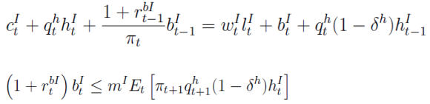


Gerali et al. (2010) (2)
Patient Households
Impatient Households
Wage setting by labour union

Slide 5


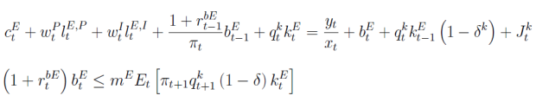

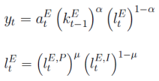



Gerali et al. (2010) (3)
Entrepreneurs
Capital goods producers
Final goods producers
Intermediary goods formation
Market clearing
Monetary policy

Slide 6

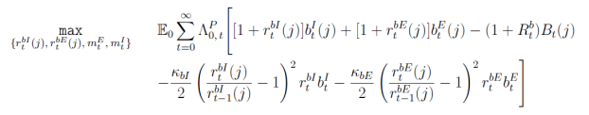








Gerali et al. (2010) (4)
Loans and deposit demand
Credit Branch
Wholesale branch
Deposit branch
Overall bank profits

Slide 7
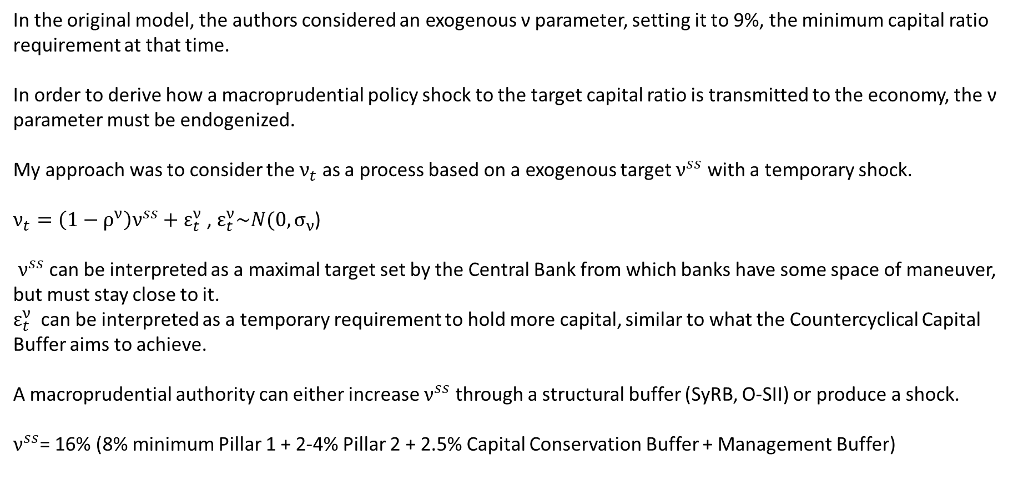
Gerali et al. (2010) (5)
In the original model, the authors considered an exogenous ν parameter, setting it to 9%, the minimum capital ratio requirement at that time.
In order to derive how a macroprudential policy shock to the target capital ratio is transmitted to the economy, the ν parameter must be endogenized.
My approach was to consider the $ν_{t}$ as a process based on a exogenous target $ν^{ss}$ with a temporary shock.
$ν_{t}=\left(1−ρ^{ν}\right)ν^{ss}+ε_{t}^{ν}$ , $ε_{t}^{ν}\sim N(0,σ_{ν}$)
$ν^{ss}$ can be interpreted as a maximal target set by the Central Bank from which banks have some space of maneuver, but must stay close to it.
$ε_{t}^{ν}$ can be interpreted as a temporary requirement to hold more capital, similar to what the Countercyclical Capital Buffer aims to achieve.
A macroprudential authority can either increase $ν^{ss}$ through a structural buffer (SyRB, O-SII) or produce a shock.
$ν^{ss}$= 16% (8% minimum Pillar 1 + 2-4% Pillar 2 + 2.5% Capital Conservation Buffer + Management Buffer)

Slide 8
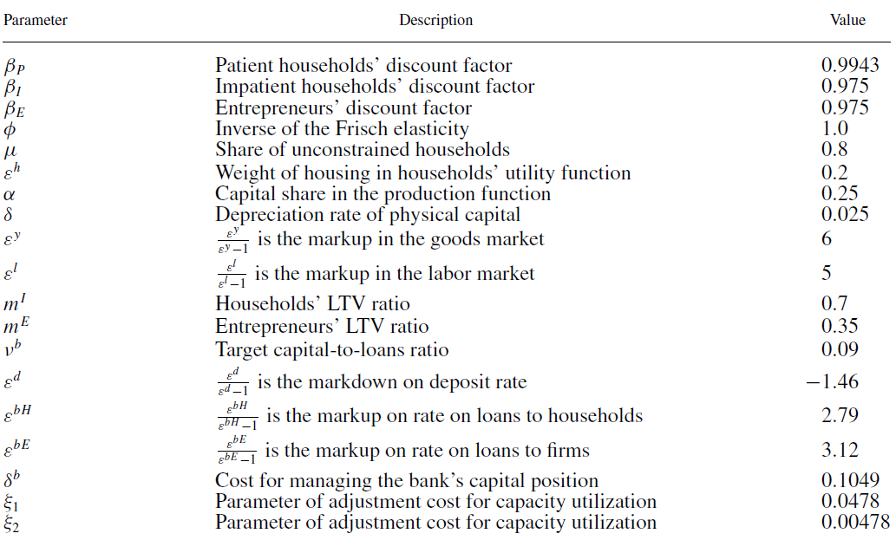

Gerali et al. (2010) (6)
Calibrated parameters
Romanian calibration
0.9963 (Copaciu et al. 2015)
7.822 (Copaciu et al. 2015)
0.9 (NBR data on no. of debitors)
0.55 (Copaciu et al. 2015)
0.049 (Copaciu et al. 2015)
0.71 (NBR FSR 2022)
$ν^{ss}$ = 0.16
-0,5767(NBR data on interest rates)
1,1728 (NBR data on interest rates)
2,53004 (NBR data on interest rates)
0.1213 (recalculation)
0.0755 (recalculation)
0.00751 (recalculation)

Slide 9
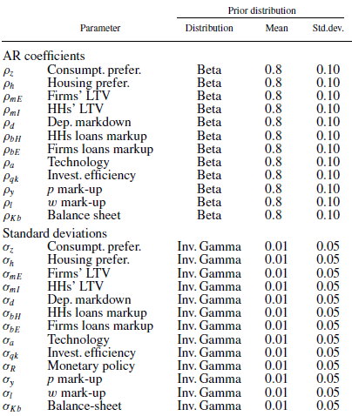
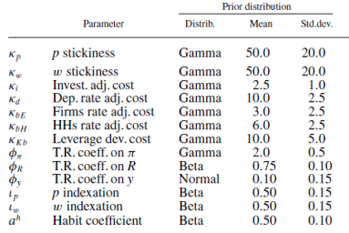
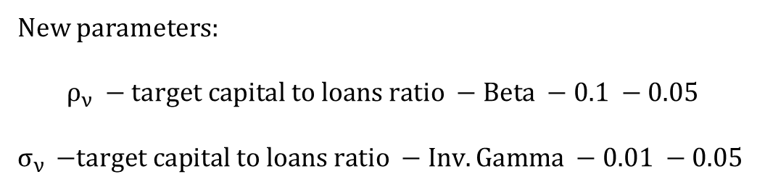
Gerali et al. (2010) (7)
Estimated parameters
New parameters:
$$ρ_{ν} −target capital to loans ratio −Beta −0.1 −0.05$$
$σ_{ν }$ $−target capital to loans ratio −Inv. Gamma −0.01 −0.05$

Slide 10
Data Series for Romania Estimation
Period: 2007 Q1 – 2022 Q4. All nominal series were deseasonalized and adjusted by the GDP deflator (Pfeifer 2014).

Slide 11
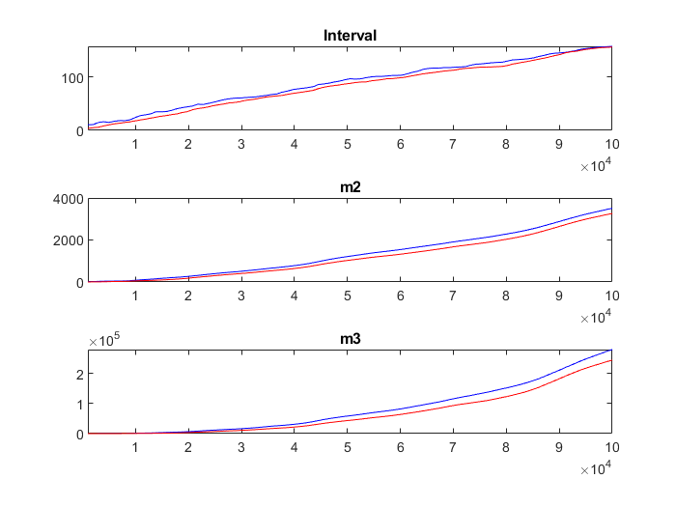
Results of estimation
Estimated parameters
Parameter | Original model estimation | Romania estimation
rho_ee_z | 0.3935 | 0.8551
rho_A_e | 0.9390 | 0.1033
rho_ee_j | 0.9212 | 0.7925
rho_me | 0.8939 | 0.9476
rho_mi | 0.9286 | 0.7983
rho_mk_d | 0.8380 | 0.9217
rho_mk_bh | 0.8195 | 0.9708
rho_mk_be | 0.8343 | 0.7726
rho_ee_qk | 0.5475 | 0.4392
rho_eps_y | 0.3047 | 0.718
rho_eps_l | 0.6399 | 0.7117
rho_eps_K_b | 0.8130 | 0.7992
kappa_p | 28.6502 | 0.6326
kappa_w | 99.8983 | 83.5904
kappa_i | 10.1822 | 4.2652
kappa_d | 3.5030 | 5.949
kappa_be | 9.3638 | 3.3435
kappa_bh | 10.0867 | 10.2549
kappa_kb | 11.0683 | 8.6416
phi_pie | 1.9816 | 2.3459
rho_ib | 0.7686 | 0.9249
phi_y | 0.3459 | 0.4357
ind_p | 0.1605 | 0.004
ind_w | 0.2757 | 0.8917
a_i | 0.8560 | 0.4086
rho_vi |  | 0.1201
Estimation done with Dynare on Matlab.
Monte Carlo Markov Chain with:
10 chains
100000 replications
50% drop rate
Good convergence, Brooks and Gelman diagnostic.
Parameter | Original model estimation | Romania estimation
var e_z | 0.0144 | 0.1408
var e_A_e | 0.0062 | 0.1109
var e_j | 0.0658 | 0.199
var e_me | 0.0034 | 0.0075
var e_mi | 0.0023 | 0.01
var e_mk_d | 0.0488 | 0.2115
var e_mk_bh | 0.0051 | 0.3339
var e_mk_be | 0.1454 | 0.0133
var e_qk | 0.0128 | 0.0932
var e_r_ib | 0.0018 | 0.0036
var e_y | 1.0099 | 1.3004
var e_l | 0.3721 | 0.2601
var e_eps_K_b | 0.05 | 0.1473
var e_vi |  | 0.2661

Slide 12
Macroprudential policy shock

Slide 13
Productivity shock

Slide 14
Take aways
Shocks are more potent using Romania’s adaptation, but much less persistent, possibly due to the effect of small economy or outcome of multiple disturbances after the The Global Financial Crisis (the original model was estimated using data from 1998 to 2009).
Macroprudential shock
Determines a short term recession: less consumption and less output
Higher capital requirements makes banks transfer the new cost to interest rates
Pacient households use deposits to maintain their consumption but eventually they run out of resources
Firms take new loans to face the shock and invest the money in capital formation, thus investment increases.
Productivity shock
Determines a short term expansion as consumption, investment and output rises
The consumption rise is due to an increase in wages of households and also due to lower borrowing costs
The production of new capital increases as interest rates lower and borrowing is advantageous
Bank capital raises due to new banking profits.
Higher ν amplifies the macroprudential policy shock, but in case of productivity shock it attenuates the response of some variables. However, the differences are small.

Slide 15



Further work
Banque de France: Bennani et al. (2018):
Endogenize ν as a process taking into account the credit-to-GDP gap, to assess the need for a CCyB:
Model housing production as in the original the housing supply is fixed:

Slide 16
References
Bennani, Taryk, Cyril Couaillier, Antoine Devulder, Silvia Gabrieli, Julien Idier, Pierlauro Lopez, Thibaut Piquard, and Valerio Scalone. "An Analytical Framework to Calibrate Macroprudential Policy.", Banque de France, Working Paper 648 (2017).
Coenen, Günter, Peter Karadi, Sebastian Schmidt, and Anders Warne. "The New Area-Wide Model II: an extended version of the ECB’s micro-founded model for forecasting and policy analysis with a financial sector.„ ECB Working Papers 2200 (2018).
Copaciu, Mihai, Valeriu Nalban, and Cristian Bulete. "REM 2.0, An estimated DSGE model for Romania." 11th Dynare Conference, Brussels, National Bank of Belgium. (2015).
Darracq Pariès, Matthieu, Pascal Jacquinot, and Niki Papadopoulou. "Parsing financial fragmentation in the euro area: a multi-country DSGE perspective.„ ECB Working Papers 1891 (2016).
Gerali, Andrea, Stefano Neri, Luca Sessa, and Federico M. Signoretti. "Credit and Banking in a DSGE Model of the Euro Area." Journal of money, Credit and Banking 42 (2010): 107-141.
Hristov, Nikolay, and Oliver Hülsewig. "Unexpected loan losses and bank capital in an estimated DSGE model of the euro area." Journal of Macroeconomics 54 (2017): 161-186.
Mendicino, Caterina, Kalin Nikolov, Javier Suarez, and Dominik Supera. "Optimal dynamic capital requirements." Journal of Money, Credit and Banking 50, no. 6 (2018): 1271-1297.
Paries, Matthieu Darracq, Christoffer Kok Sørensen, and Diego Rodriguez-Palenzuela. "Macroeconomic propagation under different regulatory regimes: Evidence from an estimated dsge model for the euro area." 27th issue (November 2011) of the International Journal of Central Banking (2018).
Pfeifer, Johannes. "A guide to specifying observation equations for the estimation of DSGE models." Research series (2014): 1-150.

Slide 17
Thank you for your attention!
mihaialiman@gmail.com
+40 722 624 828

